Slide 1
Structured Query Language (SQL) – Concepts & Practice
Abotula Yaswanth Kumar
SNS InfoTech

Slide 2
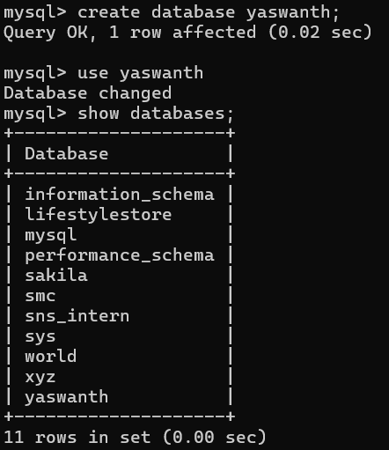
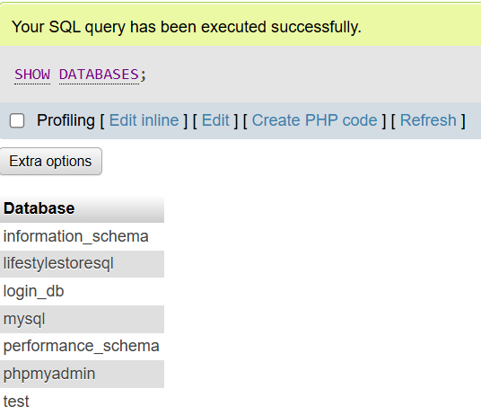
Introduction to SQL
Content:
SQL = Structured Query Language
Used to manage databases
Works with tables (rows & columns)

Slide 3
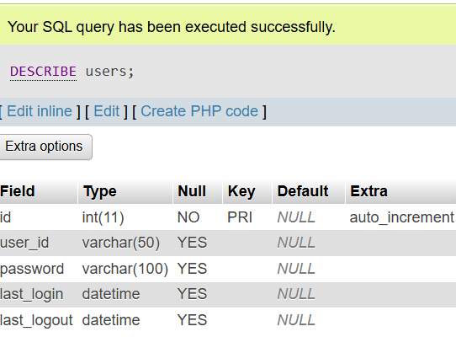
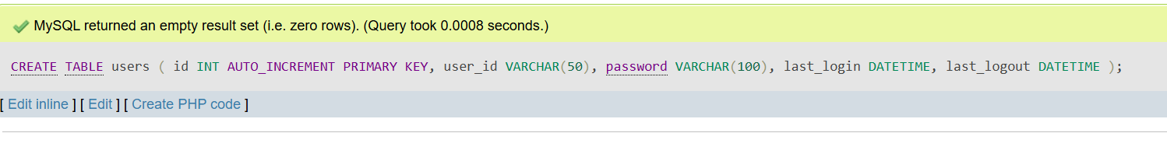
Database & Table Creation (DDL):
Concept:
DDL (Data Definition Language) is used to
define database structure
It includes commands like CREATE, ALTER, DROP

Slide 4
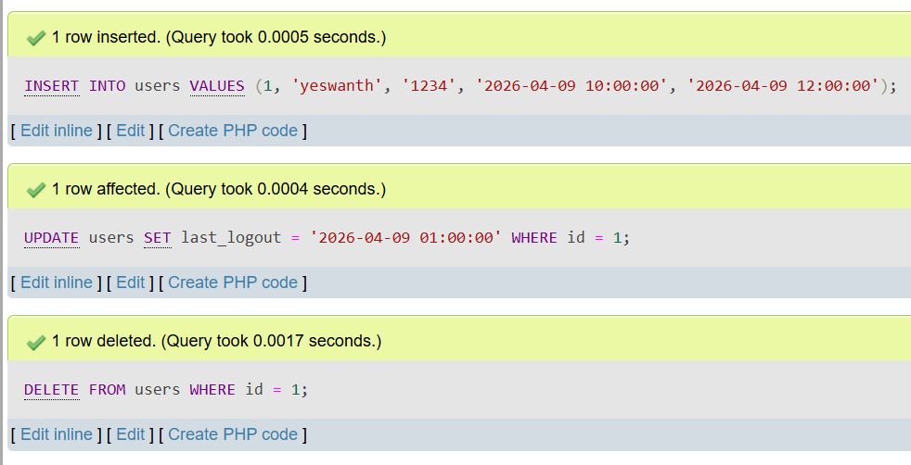
Data Manipulation (DML)
Concept:
DML is used to insert, update, and delete data in a table
Commands: INSERT, UPDATE, DELETE

Slide 5
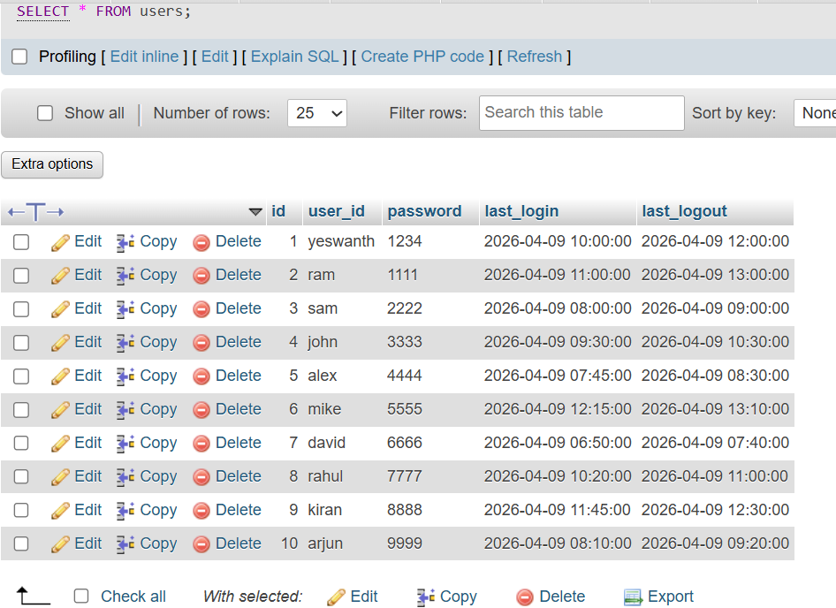
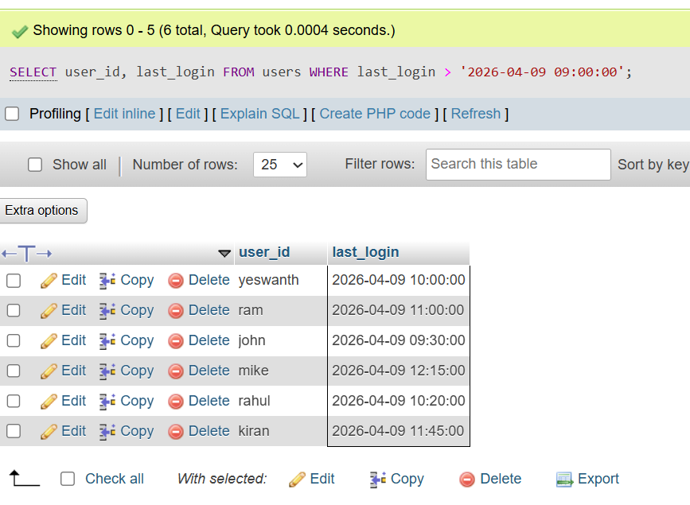
Data Query (SELECT)
Concept:
SELECT is used to retrieve data from a table
It helps in filtering, sorting, and displaying required data

Slide 6
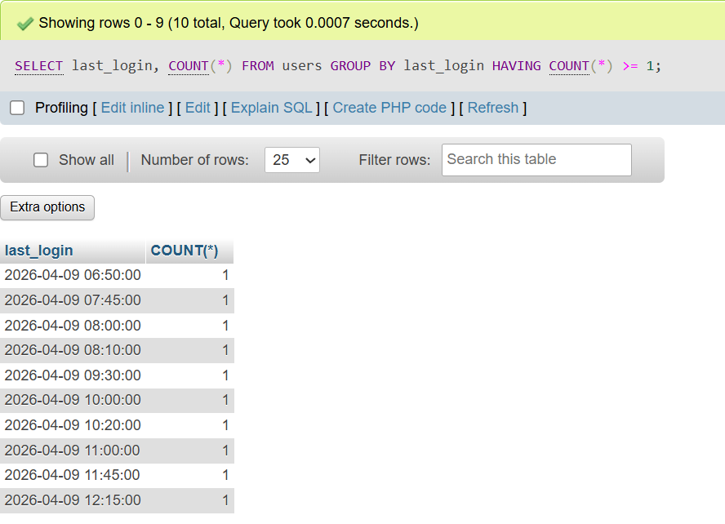
SQL Clauses (GROUP BY & HAVING)
Concept:
SQL clauses help in filtering and grouping data
GROUP BY → groups similar data
HAVING → applies condition on grouped data

Slide 7
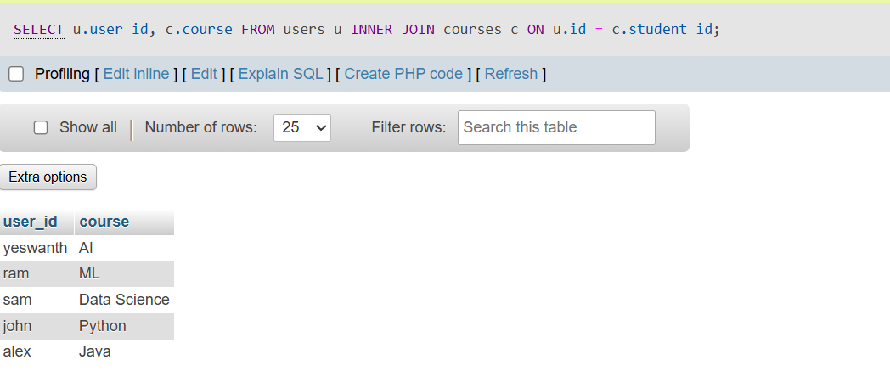
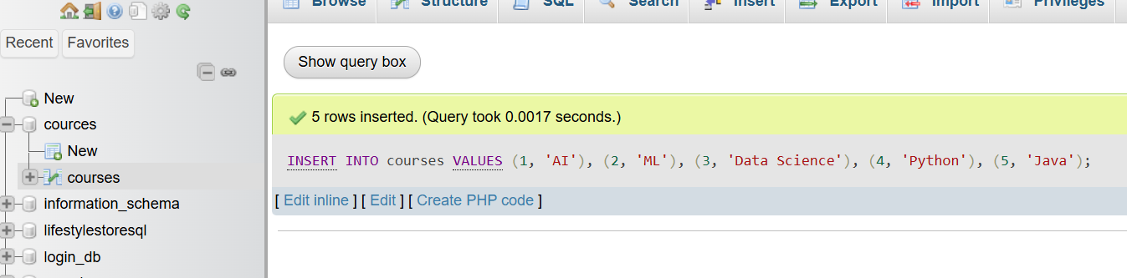
SQL Joins:
Tables Used:
users (user details)
courses (course details)

Slide 8
Conclusion
Content :
Learned basics of SQL and database management
Performed DDL, DML, and SELECT queries
Implemented real-time login/logout data handling
Used JOIN to combine multiple tables
Gained hands-on experience using phpMyAdmin

